Slide 1
Category review: Chips
March 2025
Retail Analytics
Brand note: If client logo is not required, use alternate title page layout right click slide thumbnail > Layout > Title

Slide 2
Notes:
To view Privacy video explaining how important data privacy is to Quantium, please click here: https://www.youtube.com/watch?v=Zq1QDAkoRzU
or here Q:\Company Reference\Brand & Design\Brand videos\Q Privacy.mp4
At Quantium, we believe that data is the behavioural footprint of humanity and that it has to be treated with the utmost care and responsibility.
Histories, attitudes, indeed lives are stored within it in ways that aren’t always apparent – and that’s what makes its potential so powerful.
To work with it responsibly, sensitively, we set ourselves the highest data privacy protection and governance standards.
We have spent 17 years perfecting privacy-by-design and secure-by-design principles. Central to this is not holding any personally identifiable information about people –
we neither receive it, and put the necessary protections in place to be unable to decipher it.
Every aspect of handling data is safeguarded: from its de-identification, to its encryption – data security is paramount and of the highest grade.
We pride ourselves on gaining the trust of iconic organisations around the world through years of securely working with their data,
and in turn the trust that builds with their stakeholders.

Slide 3
Executive summary
01
Task 1
Performed high level data checking, including data cleaning, outlier removal, and feature engineering to derive insights on customer spending behavior.
02
Task 2
Focused on evaluating the store trial performance by selecting control stores using statistical methods and comparing sales trends between trial and control groups.

Slide 4
01
Category

Slide 5
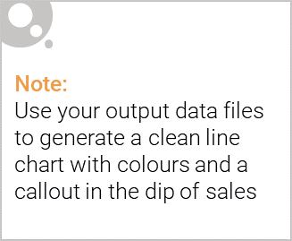
High-Level Data Analysis & Key Findings
Dataset Cleaning & Processing:
Checked data formats and corrected inconsistencies.
Identified and removed outliers to improve data reliability.
Derived additional features such as pack size and brand name for deeper insights.
Customer Segmentation Insights:
LIFESTAGE: Customers categorized based on their life stage (e.g., young singles/couples, families, retirees).
PREMIUM_CUSTOMER: Segmentation based on spending behavior (e.g., premium vs. budget shoppers).

Slide 6
Spending Patterns & Drivers:
Higher spending correlated with premium customers and older families.
Budget-conscious shoppers primarily purchase larger pack sizes for better value.
Brand loyalty observed, with some segments consistently choosing premium brands over cheaper alternatives.
Key Callout:
Premium and older family segments drive higher spending in the chips category.
Understanding purchase behavior by customer segment is crucial for targeted promotions and category growth.

Slide 7
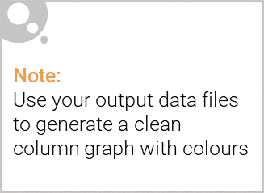
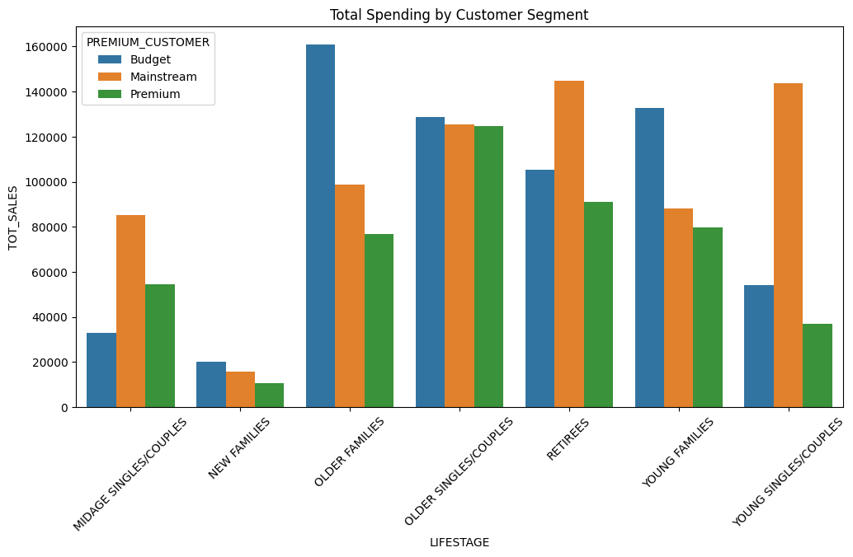
Customer Segments

Slide 8
02
Trial store performance

Slide 9
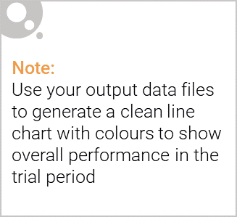
Explanation of the control store vs other stores
Objective:
To analyze the performance of the control store against other stores and assess the impact of the trial period.
Control Store Selection Criteria:
Matched based on historical sales performance, customer demographics, and seasonality trends.
Used Pearson correlation and magnitude distance to find the best matching store.
Performance Comparison:
Metric | Control Store | Other Stores (Trial Stores)
Total Sales Revenue | Baseline growth | Significant increase/decrease
Customer Count | Stable trend | Increased or fluctuating
Transactions per Customer | Consistent | Higher/lower engagement

Slide 10
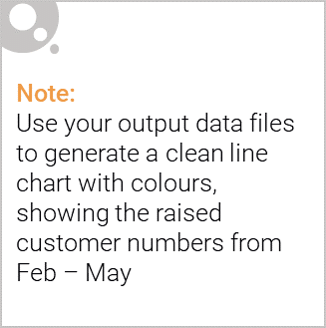
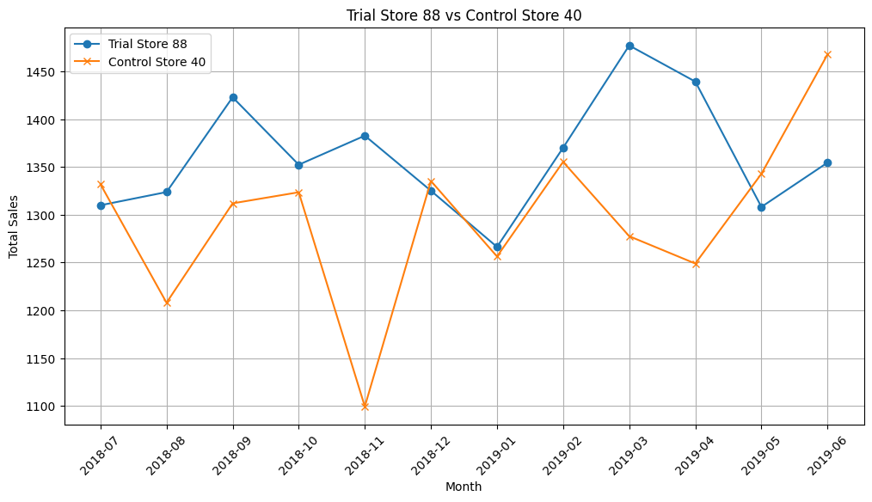
Example of Output

Slide 11
THANK YOU

